Slide 1

Verizon - How Do Customers in the USA Feel About Telco Brands? A Study Based on Unstructured Data
AI Studio Final Presentation
Program @ Cornell Tech
12/06/24

Slide 2

Introductions

Slide 3




Meet Our Team!
Christiana Nardi Virginia Commonwealth University
Eman Ahmed George Mason University
Anne-Sophie Williams College

Slide 4


Our AI Studio TA and Challenge Advisors
Dev Ashar AI Studio TA
Labanya Banerjee Challenge Advisor

Slide 5
Presentation Agenda
Project Overview
Data Understanding and Data Preparation
Modeling & Evaluation
Final Thoughts
Q&A

Slide 6
AI Studio Project Overview
Notes:
Anne-Sophie

Slide 7
“
This project involved a supervised classification challenge, where we worked with labeled data in order to classify positive and negative review sentiments.
The data we worked with was public domain data in csv format. Our team found it particularly interesting to analyze how different models performed on the data.

Slide 8
Our Goal
Our goal was to understand customer sentiment toward telecommunication brands in the US
We expected to visualize key insights into the factors that play into customer sentiments, and how to improve based on these insights
We worked using methods such as the DCC approach, data cleaning, and web scraping. We used tools such as pre-trained LLMs and several Python libraries for data visualization

Slide 9
Business Impact
Improved Customer Experience
Understanding specific areas of feedback can help address issues early and tailor services to prevent customer churning
Predictive Insights
Identifying patterns of dissatisfaction can help predict potential churning, allowing for proactive measures to be taken
Competitive Advantage
Predicting negative feedback and repairing these areas can help strengthen customer relationships and maintain a positive brand image

Slide 10
Our Approach
MILESTONE 1
MILESTONE 2
MILESTONE 3
MILESTONE 4
MILESTONE 5
MILESTONE 6
LLM Model Selection
Sentiment Analysis
Data Collection and Preprocessing
Fine-Tuning and Fitting Model to Data
Evaluation and Optimization
Derive Insights and Visualize Results
Downloaded the data; handled missing values and outliers; and performed exploration, tokenization, and feature engineering
Researched models, compared performances, and selected the most suitable LLM model
Trained the models using a preprocessed dataset and fine-tuned parameters for optimal performance
Trained the models to classify sentiment as positive or negative
Assessed model performances and improved results based on evaluative measures
Visualized results through plots and charts, and documented findings

Slide 11






Resources We Leveraged
Workspace
Google Colab
Data source
Kaggle
Python Libraries
Pandas, NumPy, Scikit-learn, Transformers, and Matplotlib
Models:
BERT, LaMa, GPT
File Storing
Google Drive
Version Control:
Github

Slide 12
Data Understanding & Data Preparation
Notes:
Eman

Slide 13
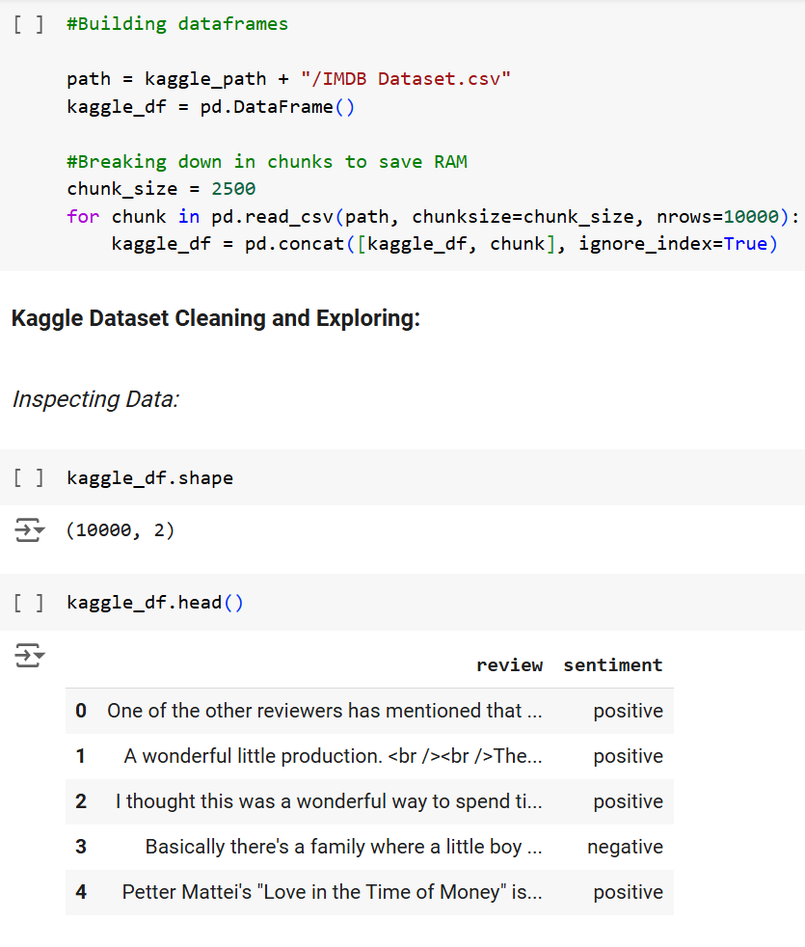
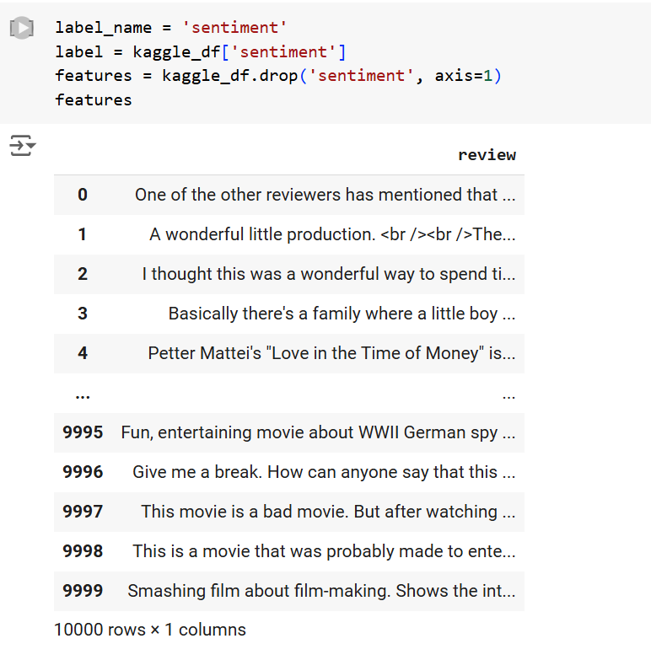
[Insert title]
[Insert your text/visuals]
Notes:
Eman
The first block of code reads a large CSV file in chunks of 2,500 rows at a time, processes up to 10,000 rows, and combines the chunks into a single pandas DataFrame to save memory. The second block separates the sentiment column from the kaggle_df DataFrame into a variable called label, and creates a new DataFrame features containing all the columns except sentiment.

Slide 14

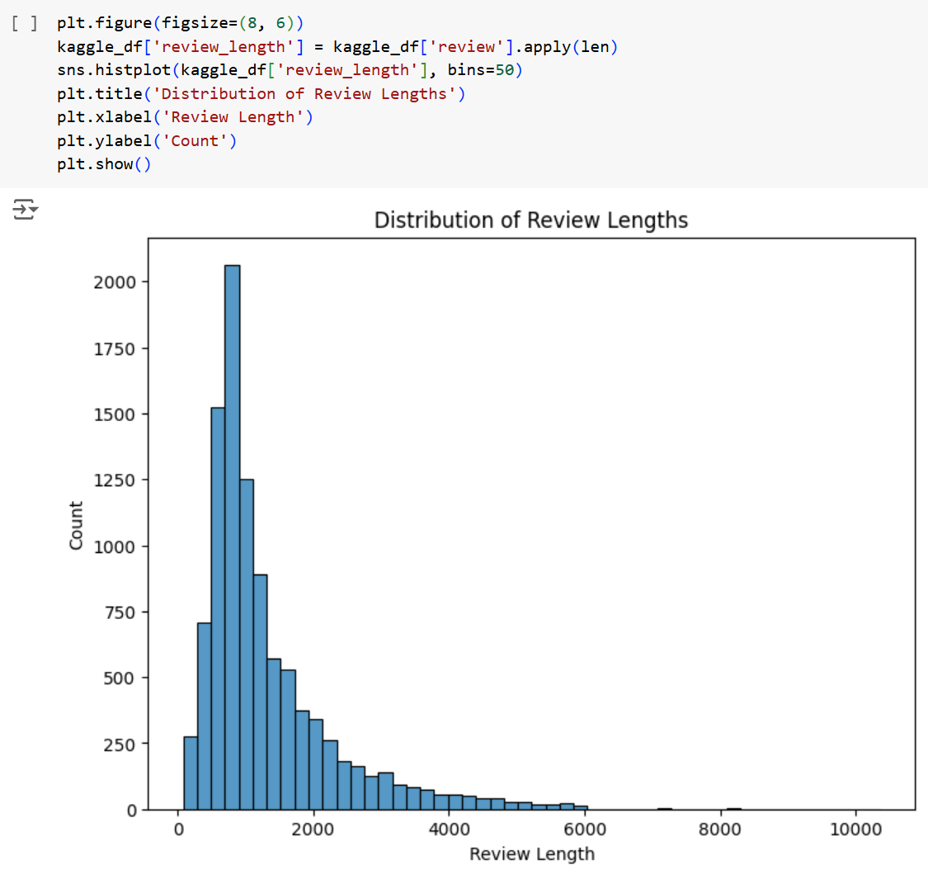
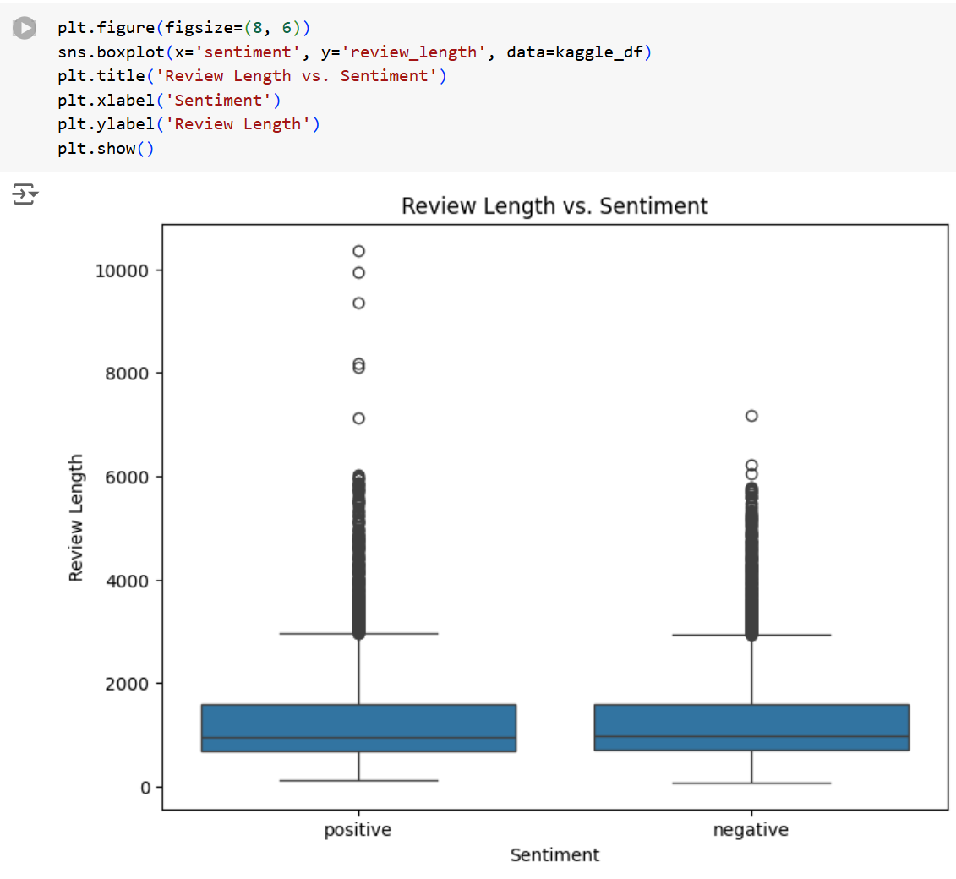
[Insert image and/or code snippet]
[Insert title]
Notes:
Eman
The code creates a histogram showing the distribution of review lengths in the dataset by calculating the length of each review. The second block creates a boxplot to compare the distribution of review lengths for each sentiment category in the dataset.

Slide 15
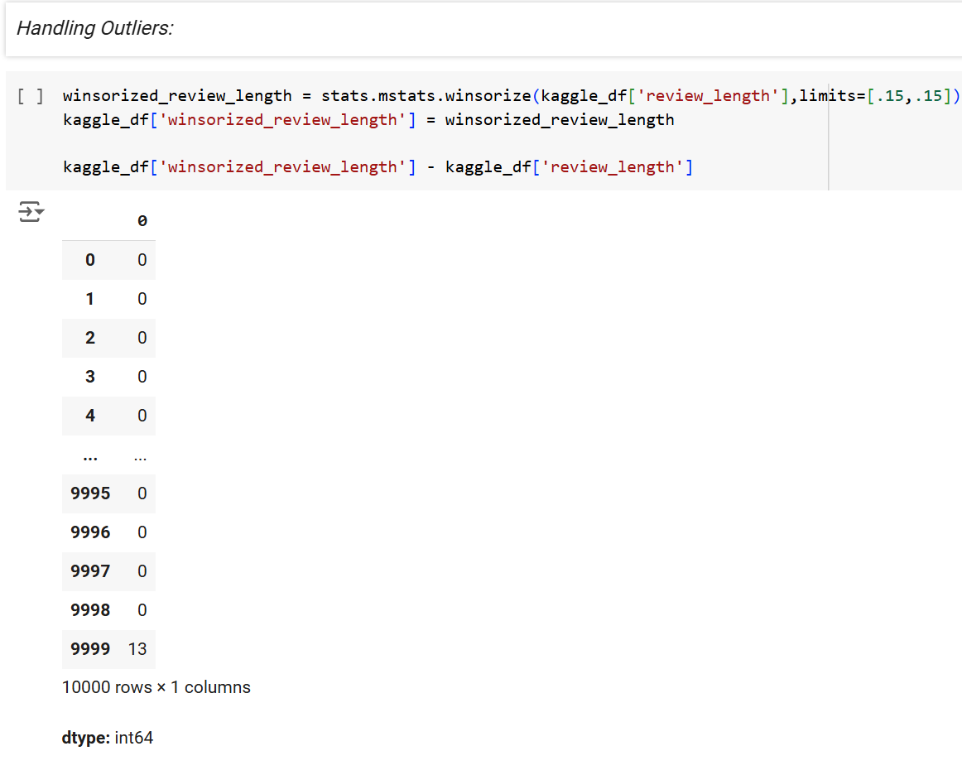
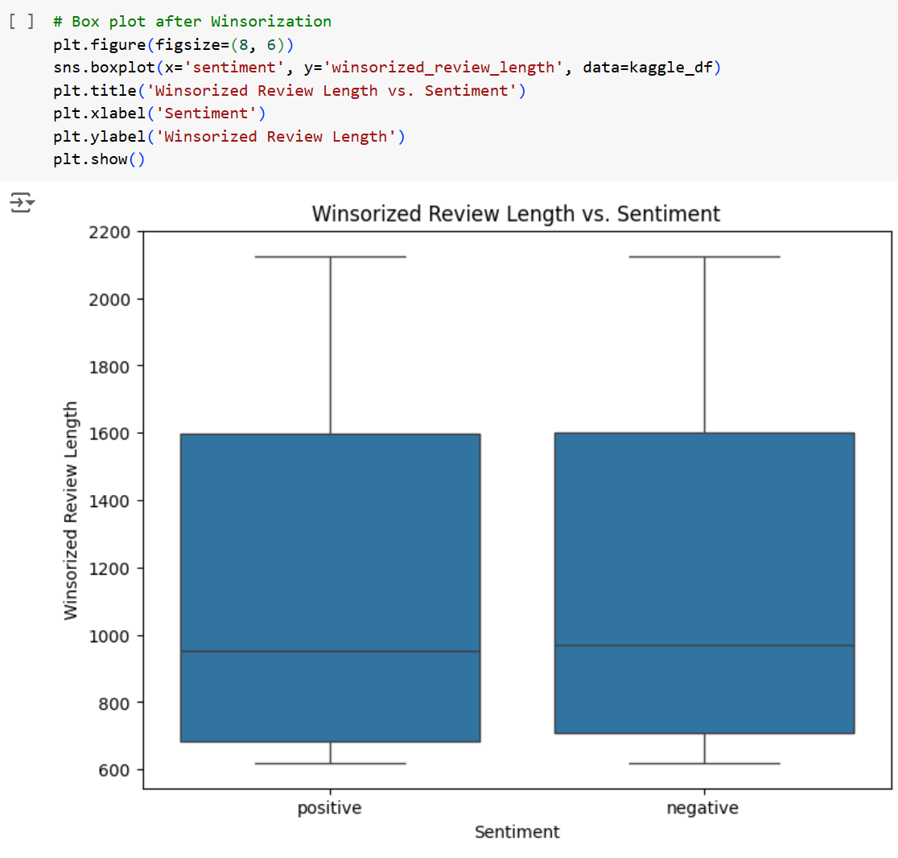
[Insert image and/or code snippet]
[Insert title]
Notes:
his code applies winsorization to the review_length column to limit extreme values at both ends (15% from the lower and upper tails) and creates a new column, winsorized_review_length, with the modified values.
Finally, it calculates the difference between the winsorized_review_length and the original review_length, showing how much each review length was adjusted during winsorization. The second block This code creates a boxplot to compare the distribution of winsorized review lengths for each sentiment category, visualizing the effect of winsorization on the relationship between review length and sentiment.

Slide 16
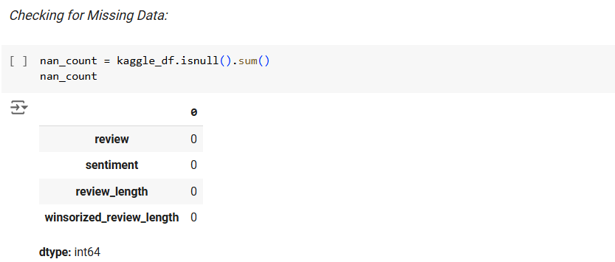
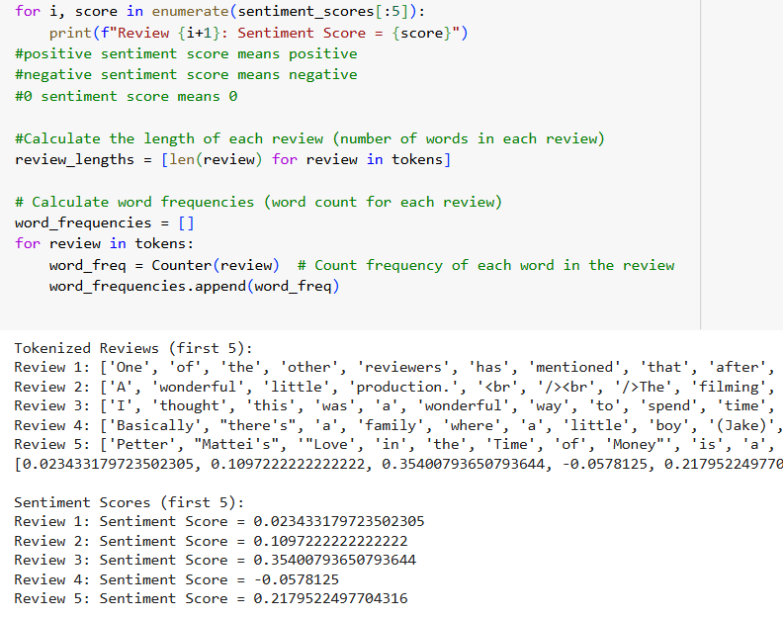
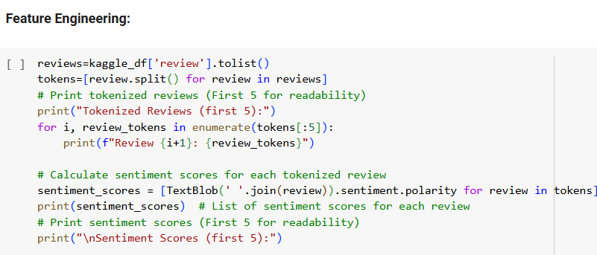
[Insert title]
Notes:
Then we check for missing data. Then comes feature engineering. The code processes a dataset of reviews to split each review into words, calculate and print their sentiment scores (positive, negative, or neutral), measure the length of each review, and count how often each word appears in each review

Slide 17
Modeling & Evaluation
Notes:
Christiana

Slide 18

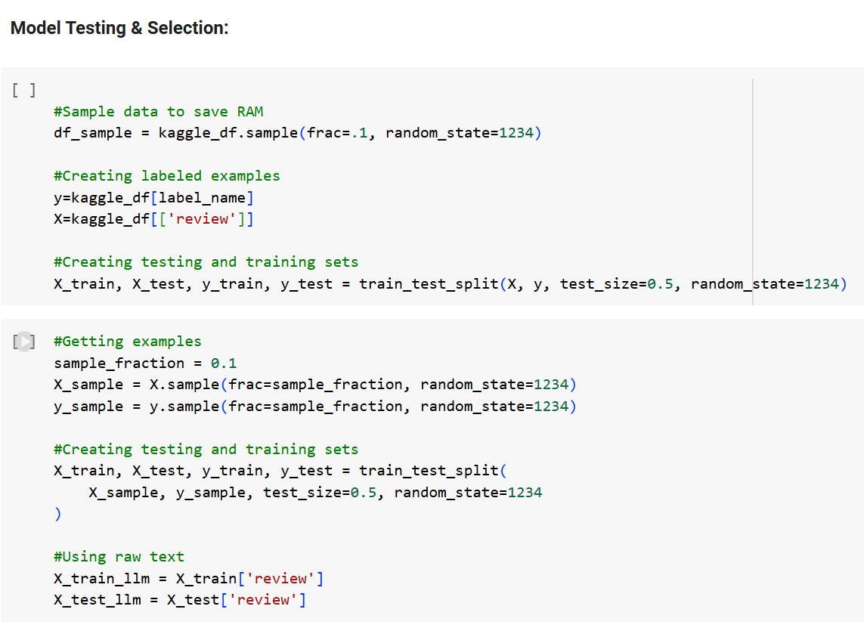

Slide 19
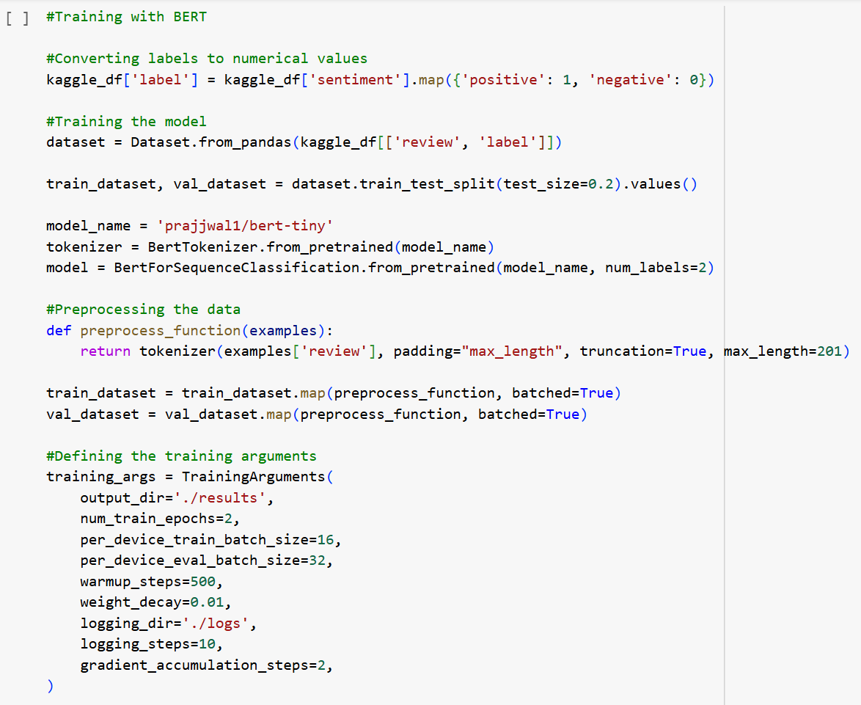
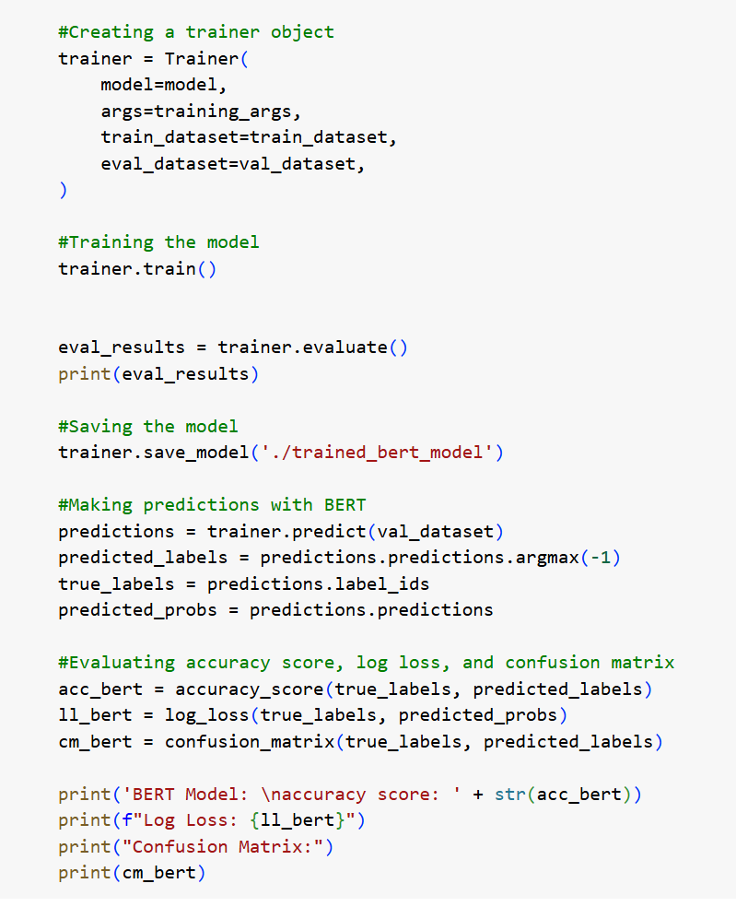
BERT

Slide 20
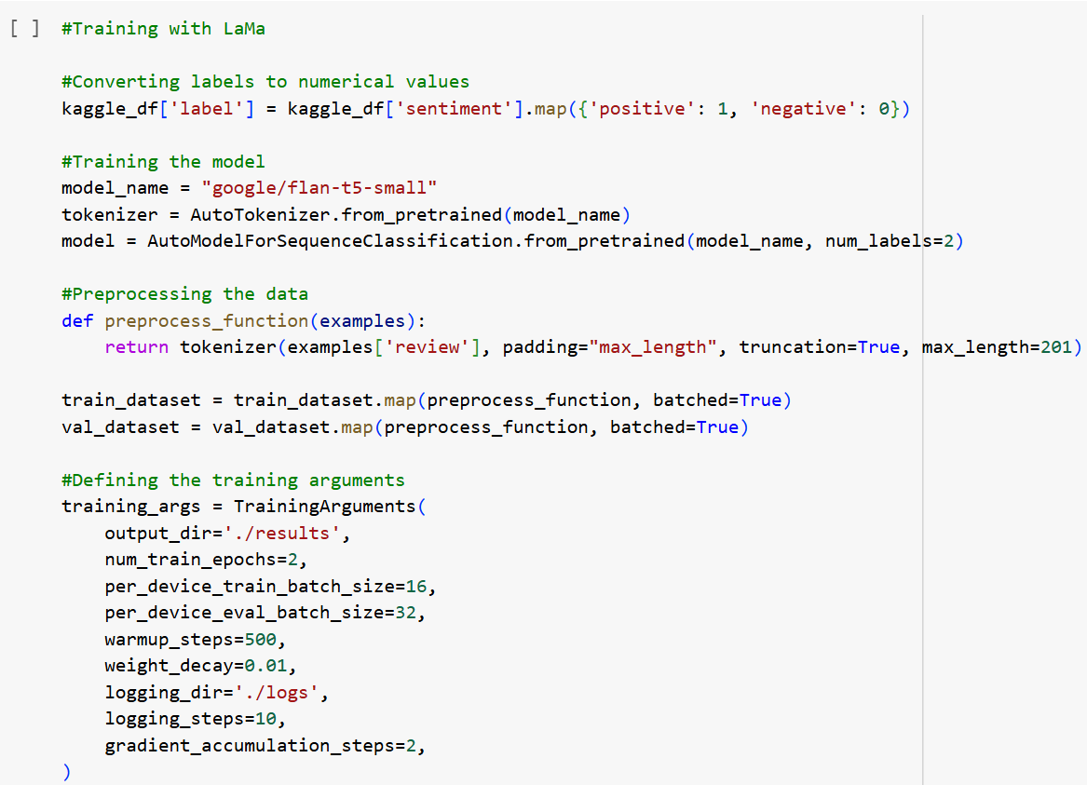
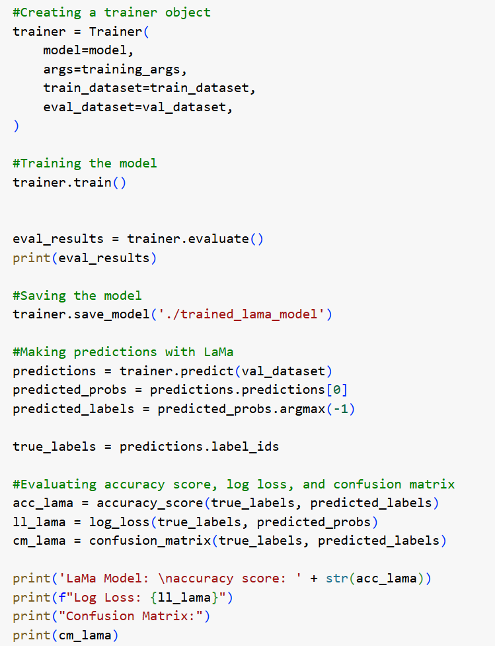
LAMA

Slide 21
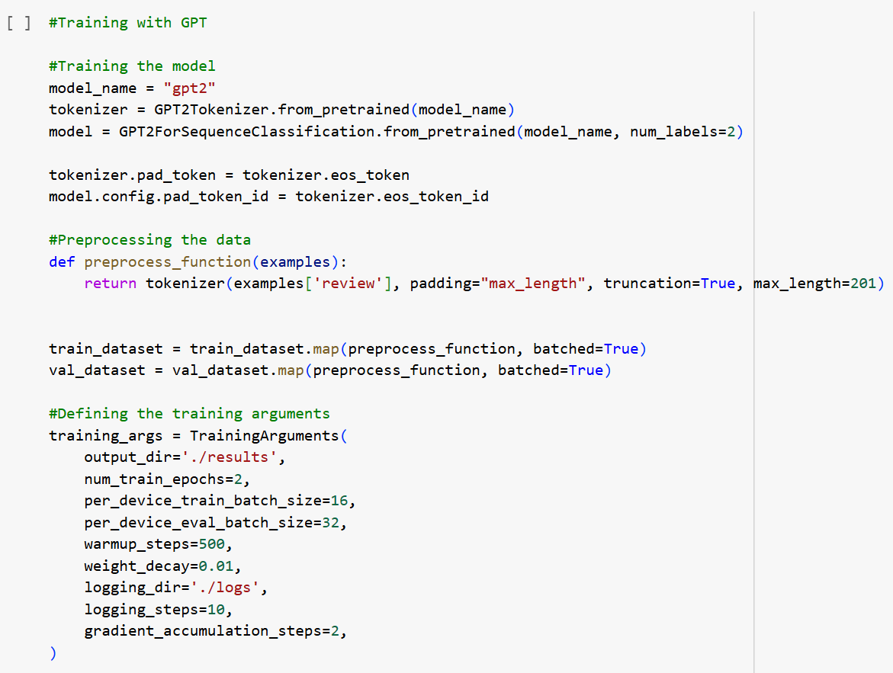
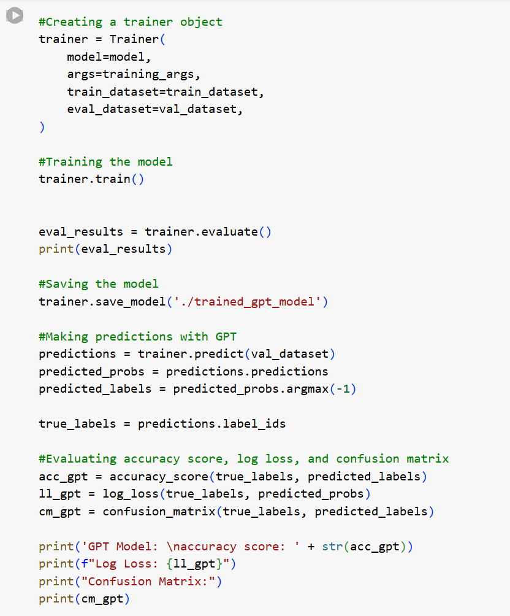
GPT

Slide 22
Model Comparison
Model Name | Description | Results | Pros | Cons
BERT | Accuracy Score: Log Loss: Eval Loss: | .7225 5.3666583784698005 0.5504934191703796 | High speed, good context understanding | Lowest accuracy, highest loss overall
LAMA | Accuracy Score: Log Loss: Eval Loss: | 0.892 0.7670366625664069 0.2851766347885132 | High accuracy, low log loss | Slower evaluation than BERT, higher eval loss than GPT
GPT | Accuracy Score: Log Loss: Eval Loss: | 0.892 1.543650751449529 0.2575629949569702 | High accuracy, low evaluation loss | Slower evaluation than BERT, higher log loss than LAMA

Slide 23
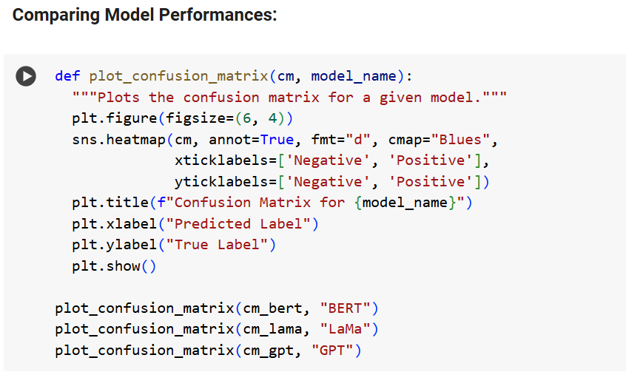
[Insert image and/or code snippet]

Slide 24
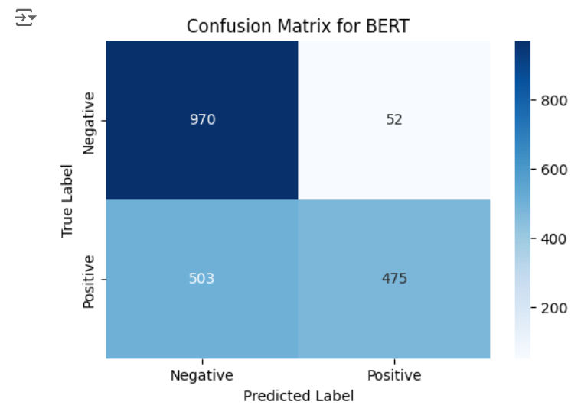
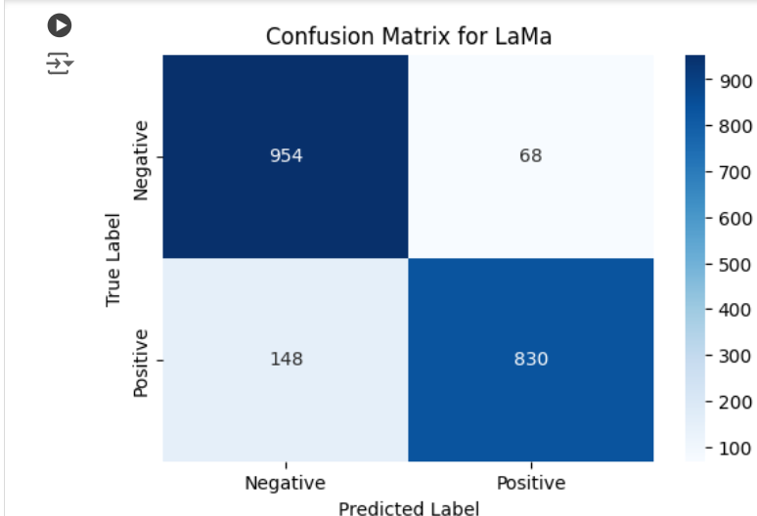
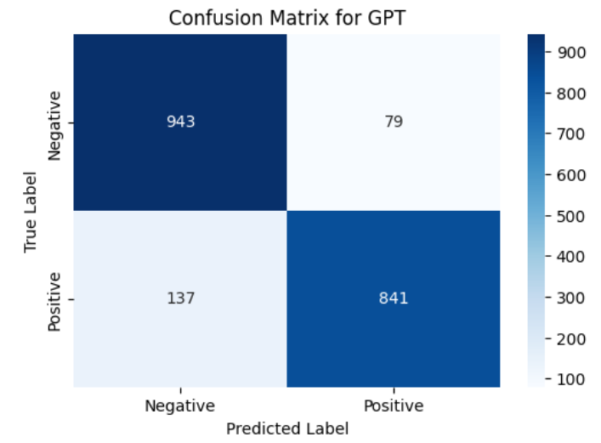
[Insert image and/or code snippet]
Confusion Matrix Comparisons

Slide 25
Insights and Key Findings
LaMa deemed the best performing model
It has the best balance of high accuracy and low log loss
While not the fastest, LaMa still has a reasonable runtime

Slide 26
Final Thoughts
Notes:
Eman

Slide 27
What We Learned
Working with Large Language Models
Bert, LaMa, GPT
New feature engineering methods
Tokenizing, data chunking, etc.
New Libraries
Torch, BertForSequenceEvaluation, BertTokenizer, GPT2ForSequenceEvaluation, GPT2Tokenizer, Trainer, TrainingArguments, AutoTokenizer, AutoModelSequenceClassification, TextBlob, Counter
New Installs
Transformers, Datasets, Accelerate, BitsAndBytes

Slide 28
Potential Next Steps
Continue model evaluation with further hyperparameter tuning
Experiment with new LLM models
Incorporate additional datasets for new training data
Combine model performances with ensemble methods

Slide 29

Questions?

